Slide 1
HOTEL RESERVATION ANALYSIS

Slide 2
The hotel industry relies on data to make informed decisions and provide a better guest experience. In
this presentation, I have worked with a hotel reservation dataset to gain insights into guest preferences,
booking trends, and other key factors that impact the hotel's operations. I have used SQL to query and
analyze the data, as well as answer specific questions about the dataset.
Dataset Details:
The dataset includes the following columns:
• Booking_ID: A unique identifier for each hotel reservation.
• no_of_adults: The number of adults in the reservation.
• no_of_chi ldren: The number of children in the reservation
.• no_of_weekend_nights: The number of nights in the reservation that fall on weekends.
• no_of_week_nights: The number of nights in the reservation that fall on weekdays.
• type_of_meal_plan: The meal plan chosen by the guests.
• room_type_reserved: The type of room reserved by the guests.
• lead_time: The number of days between booking and arrival.
• arrival_date: The date of arrival
• market_segment_type: The market segment to which the reservation belongs.
• avg_price_per_room: The average price per room in the reservation.
• booking_status: The status of the booking.

Slide 3

1). What is the total number of reservations in the dataset?
select count(booking_ID) as total_number_of_reservations from hotel_reservation;
OUTPUT
RESULT
The total number of reservations in the dataset is 700.

Slide 4

2). Which meal plan is the most popular among guests
select count(*)type_of_meal_plan,type_of_meal_plan from hotel_reservation group by type_of_meal_plan;
OUTPUT
RESULT
Meal Plan 1 is more popular among guests.

Slide 5

3).What is the average price per room for reservations involving children?
select sum(no_of_children)as children,round(avg(avg_price_per_room))as average_price_per_room from hotel_reservation where no_of_children>0;
OUTPUT
RESULT
The average price per room for reservations involving children is 145

Slide 6
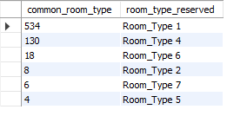
5).What is the most commonly booked room type?
select count(room_type_reserved)as common_room_type,room_type_reserved from hotel_reservation group by room_type_reserved
order by common_room_type desc;
OUTPUT
RESULT
The most commonly booked room type is Room Type 1.

Slide 7

6).How many reservations fall on a weekend (no_of_weekend_nights > 0)?
select count(no_of_weekend_nights) from hotel_reservation where no_of_weekend_nights >0 ;
OUTPUT
RESULT
The number of reservations fall on a weekend is 383.

Slide 8

7).What is the highest and lowest lead time for reservations
select min(lead_time) as lowest_lead_time,max(lead_time)as highest_lead_time from hotel_reservation;
OUTPUT
RESULT
The highest lead time is 443 days and lowest lead time is 0 days

Slide 9

8).What is the most common market segment type for reservations
select max(market_segment_type) as most_common_market_sfrom hotel_reservation;
select count(market_segment_type)as common_market_segment,market_segment_type from hotel_reservation group by market_segment_type
order by common_market_segment desc;
OUTPUT
RESULT
The most common market segment type for reservation is online.

Slide 10

9).How many reservations have a booking status of "Confirmed"
select count(booking_status) from hotel_reservation where booking_status="confirmed";
OUTPUT
RESULT
booking status confirmed has 0 reservations

Slide 11

10).What is the total number of adults and children across all reservations?
select sum(no_of_adults)as total_adults,sum(no_of_children)as total_children from hotel_reservation;
OUTPUT
RESULT
The total number of adults are 1316 and children are 69 across all reservations.

Slide 12

11).What is the average number of weekend nights for reservations involving children?
select avg(no_of_weekend_nights) from hotel_reservation where no_of_children>0;
OUTPUT
RESULT
The average number of weekend nighs is 1.

Slide 13
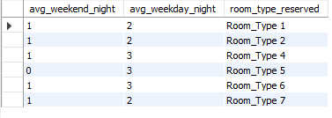
13).What is the average number of nights (both weekend and weekday) spent by guests for each room type
select round(avg(no_of_weekend_nights))as avg_weekend_night,round(avg(no_of_week_nights)) as avg_weekday_night,
room_type_reserved from hotel_reservation group by room_type_reserved order by room_type_reserved ;
OUTPUT
RESULT
The average number of nights both weekend and weekday is given in the table.

Slide 14
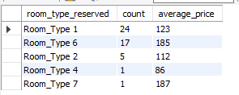
14).For reservations involving children, what is the most common room type, and what is the average price for that room type?
select room_type_reserved,count(room_type_reserved)as count ,round(avg(avg_price_per_room)) as average_price from hotel_reservation
where no_of_children>0 group by room_type_reserved order by count desc;
OUTPUT
RESULT
The most common room type is Room_type 1
and the average price is 123

Slide 15
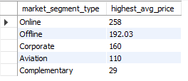

15).Find the market segment type that generates the highest average price per room.
select market_segment_type,avg_price_per_room from hotel_reservation
where avg_price_per_room in (select max(avg_price_per_room) from hotel_reservation);
select market_segment_type,max(avg_price_per_room) as highest_avg_price from hotel_reservation group by market_segment_type order by highest_avg_price desc;
OUTPUT 2
OUTPUT 1
RESULT
The market segment type that generates highest average price per room is online market with average price of 258.

Slide 16
THANK YOU

